Slide 1

CAPSTONE PROJECT by DBI002 Group-4
Capstone Project By
Rakesh Kumar dbi002_rakesh@iimnagpur.ac.in

Slide 2



Problem Statement
High rate of credit card defaulters within American Express Credit Card, which poses significant financial risks and negatively impacts the overall profitability and reputation of the company
Problem Description: Credit card defaulters refer to customers who fail to make timely payments on their credit card balances, resulting in unpaid debts and potential financial losses for the company. This problem has several dimensions:
Magnitude: The number of credit card defaulters has been increasing steadily, leading to a significant amount of outstanding debt. This trend indicates a potential threat to the organization's financial stability and profitability.
Financial Impact: Credit card defaulters create a strain on the company's cash flow as unpaid debts accumulate. This impacts our ability to meet financial obligations, pay suppliers, and invest in growth initiatives. It also increases the risk of incurring bad debt expenses.
Reputation: Persistent credit card defaulters reflect poorly on our organization's reputation. It may lead to negative reviews, decreased customer trust, and difficulty in acquiring new customers. Maintaining a positive image is crucial for sustained growth and success in the competitive market.
Regulatory Compliance: Non-payment of credit card balances may result in legal and regulatory issues. Failure to comply with relevant laws and regulations can attract penalties and damage our standing with regulatory authorities.
Customer Experience: Credit card defaulters often experience financial hardship, leading to strained relationships with customers. This can harm customer loyalty and satisfaction, affecting the overall customer experience.

Slide 3

Problem Statement – Need of the Project
Objective: The objective is to develop and implement effective strategies to minimize the rate of credit card defaulters, reduce outstanding debt, improve cash flow, safeguard the company's reputation, ensure compliance with regulations, and enhance the overall customer experience.

Slide 4
Brief detail about datasets
Y=mx+C
Data Description (Y-Response Variable)
Default of credit card clients.xls- default payment (Yes = 1, No = 0), as the response variable
Data Fields (X-Explanatory Variables)
This study reviewed the literature and used the following 23 variables as explanatory variables:
X1: Amount of the given credit (NT dollar): it includes both the individual consumer credit and his/her family (supplementary) credit.
X2: Gender (1 = male; 2 = female).
X3: Education (1 = graduate school; 2 = university; 3 = high school; 4 = others).
X4: Marital status (1 = married; 2 = single; 3 = others).
X5: Age (year).

Slide 5
X6 - X11: History of past payment. We tracked the past monthly payment records (from
April to September, 2005) as follows:
X6 = the repayment status in September, 2005;
X7 = the repayment status in Aug, 2005;
X8 = the repayment status in Jul, 2005;
X9 = the repayment status in Jun, 2005;
X10 = the repayment status in May, 2005;
X11 = the repayment status in Apr, 2005;
The measurement scale for the repayment status is:
-1 = pay duly; 1 = payment delay for one month; 2 = payment delay for two months; . . .; 8 = payment delay for eight months; 9 = payment delay for nine months and above.
X12-X17: Amount of bill statement (NT dollar). X12 = amount of bill statement in September, 2005; X13 = amount of bill statement in August, 2005; . . .; X17 = amount of bill statement in April, 2005.
X3: Education (1 = graduate school; 2 = university; 3 = high school; 4 = others)
X18-X23: Amount of previous payment (NT dollar). X18 = amount paid in September, 2005; X19 = amount paid in August, 2005; . . .;X23 = amount paid in April, 2005.X5: Age (year).

Slide 6
Data Pre- Processing
Data wrangling and processing requires cleaning of data and preparing it for further analysis. Our
cleaning process involved the following parts:
Replacing the PAY_0 to PAY_1 from 0 to 1 in order to maintain the sequence
Changing the column names from integer to month names for better readability down the line
Creating Age Buckets Column for further analysis
There was a lot of invalid data in columns such as Education, Marriage
Education was had 5,6,0 values which had no meaning. Hence we imputed it to 0 i.e. others
Marriage had 0 values hence we imputed it to 3 i.e. others have created a new column called ‘Competition Open’ from existing columns to measure more accurate period in months from when the nearest competition has opened.
Then we replaced the negative values present in ‘Promo Open’ and ‘Competition Open’ with zero value.

Slide 7
Null Value Treatment:
Since it is a payment history data we were lucky there were no null values in our dataset
Handling Outliers:
Our dataset had Number of rows: 30000 and Number of columns:26 before outlier treatment
We used box plot method to detect the outliers
Since 90 percent of our PAY data lies between -2 and 1 we will remove rest of the observations
Removing outliers using z score method on Limit Balance column.
We Treated Age Column by dropping values more than 61 as 90 % of our data was less than 62
We Treated Education Column by dropping values more than 4 as 90 % of our data was less than 5

Slide 8
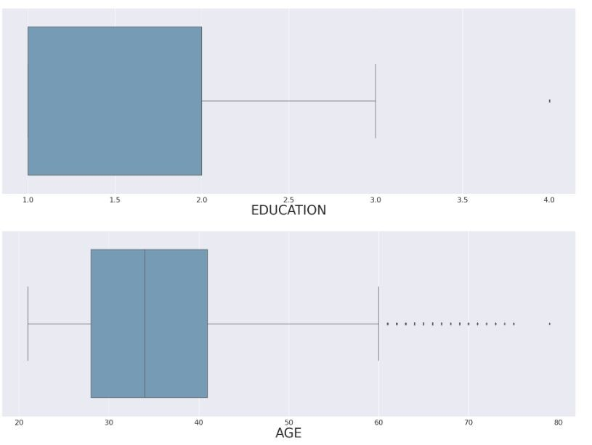
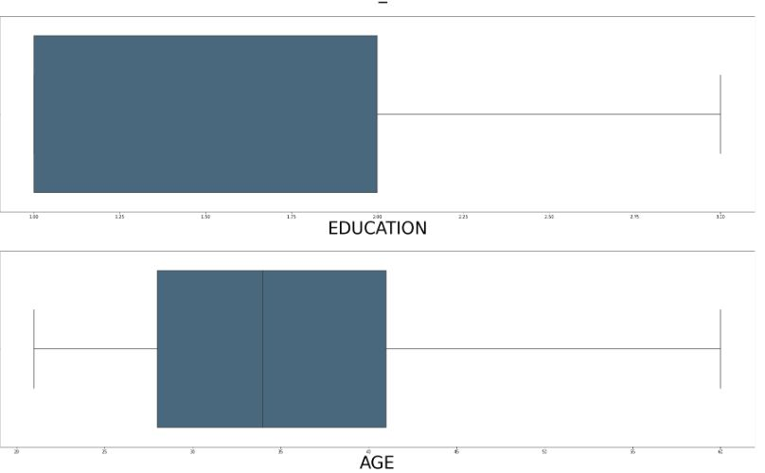
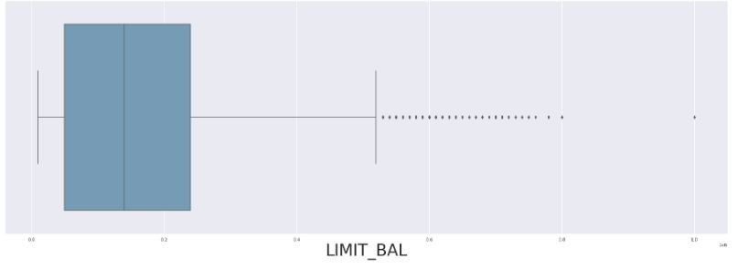
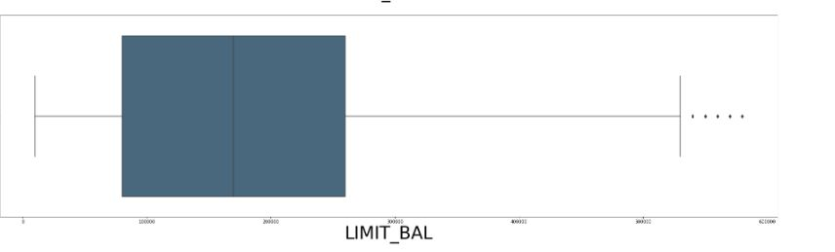
Handling Outliers:
After Outlier Treatment – Number of Rows:20928 & Number of coloumn:26
Further outlier treatment was done at later stages by creating two columns Payement_Value and Dues that treated both outliers as well as reduced multicollinearity heavily.
Before Outlier treatment
After Outlier treatment

Slide 9
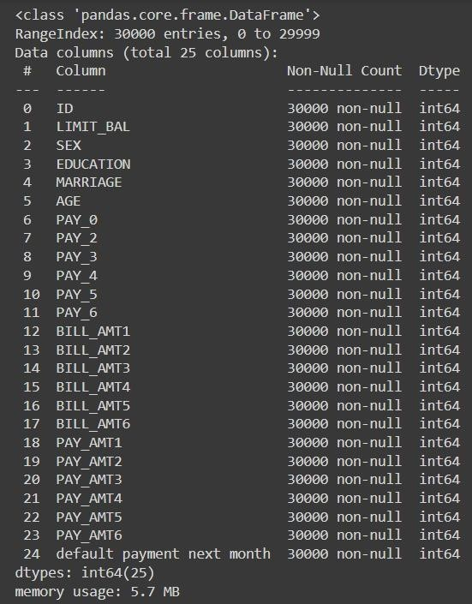
Exploratory Data Analysis
BASIC Information about our dataset
Dataset for customers default payments
Shape of data is 30000 rows and 25 columns
Six months payment and bill data available.
No null data.
Nine Categorical variables present.
ID column can be dropped

Slide 10
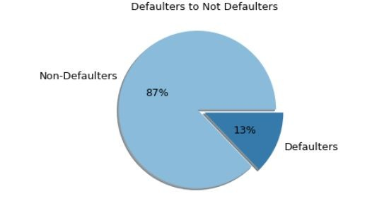
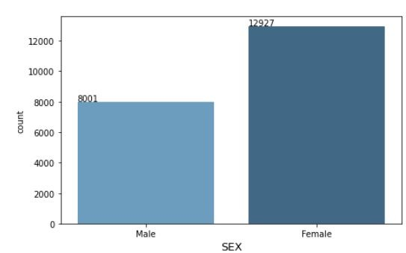
Ratio of Defaulter to Non-Defaulter
In our dataset the ratio of defaulter to
non defaulter is 78:22
That is 22% are defaulters while the rest
pays on time
GENDER DISTRIBUTION
In our dataset,
There are 11,888 Males or 39%
And 18,112 Females or 61%.

Slide 11
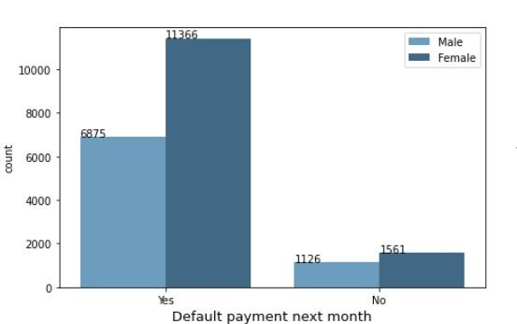
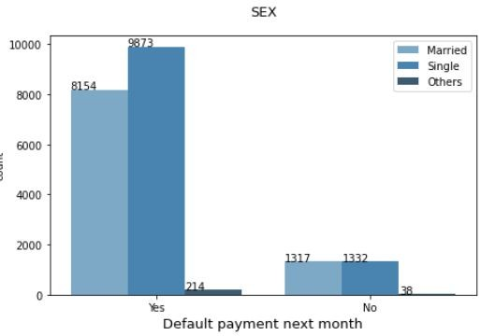
DEFAULTER RATIO WITH RESPECT TO GENDER
The Defaulter ratio with respect to gender is 43%
of Males are defaulter while 57% of Females are
defaulter.
DEFAULTER RATIO WITH RESPECT TO MARITAL STATUS
The defaulter ratio according to marital status are as follows:
Married : 50%
Single : 49%
Others : 1%
The above calculation says that Married people are more
likely to fail to pay on time while Single people often pays
on time.

Slide 12
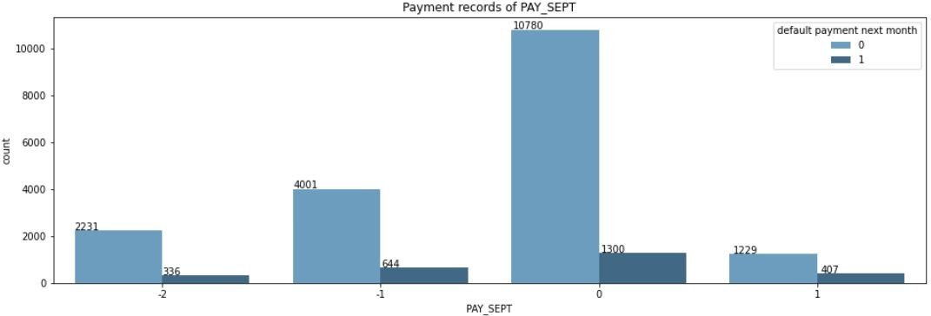
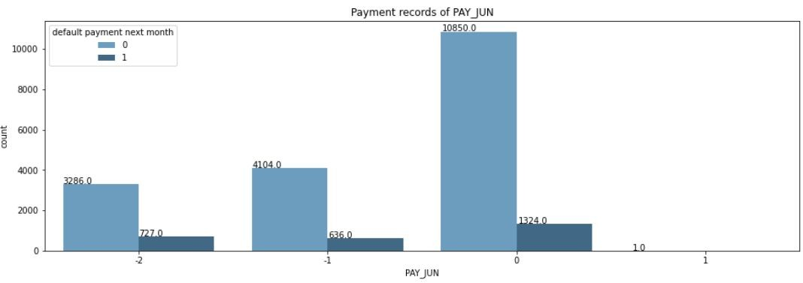
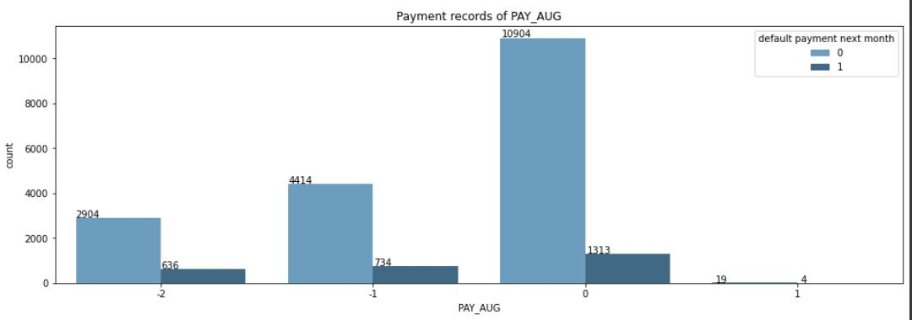
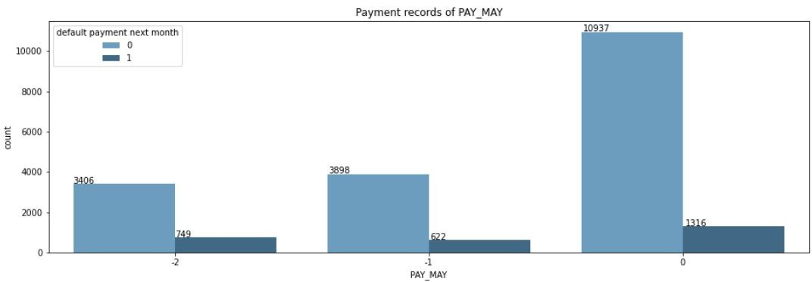
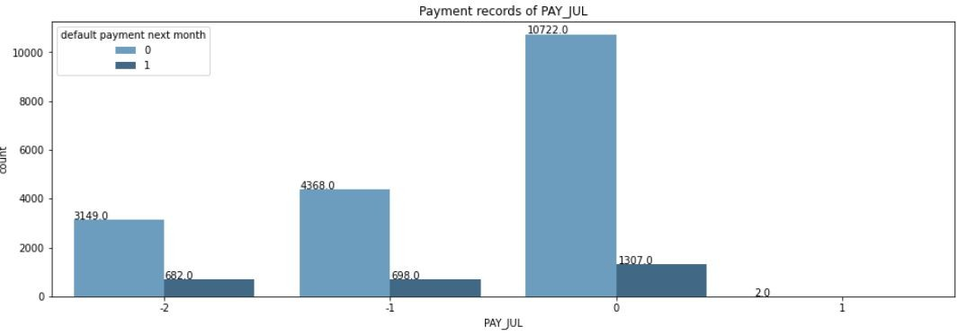
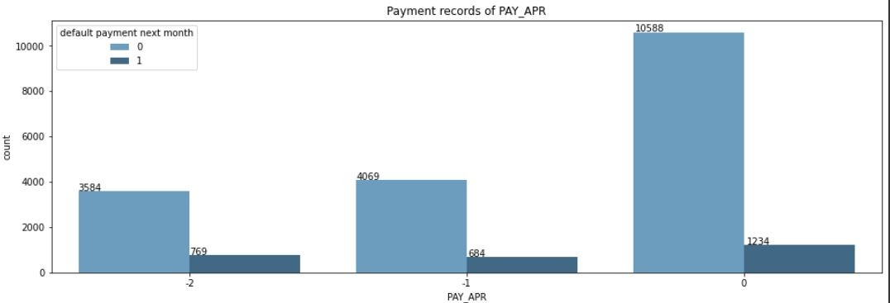
From history of past payment it is clear that most people who pay duly are not likely to default their payment

Slide 13
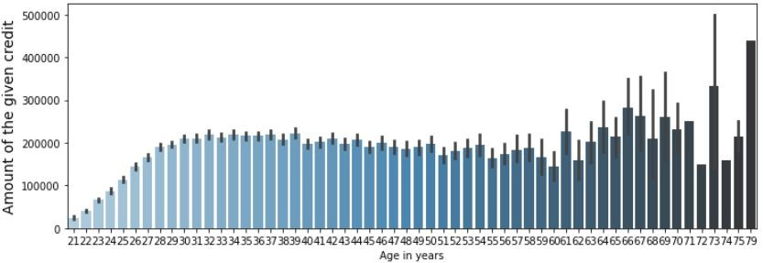
Trend of limit balance is mixed from age 21 to 39, it is increasing after it has declined a bit but from 62 it is increasing the limit has increased drastically.
Highest balance given to the age of 79.

Slide 14
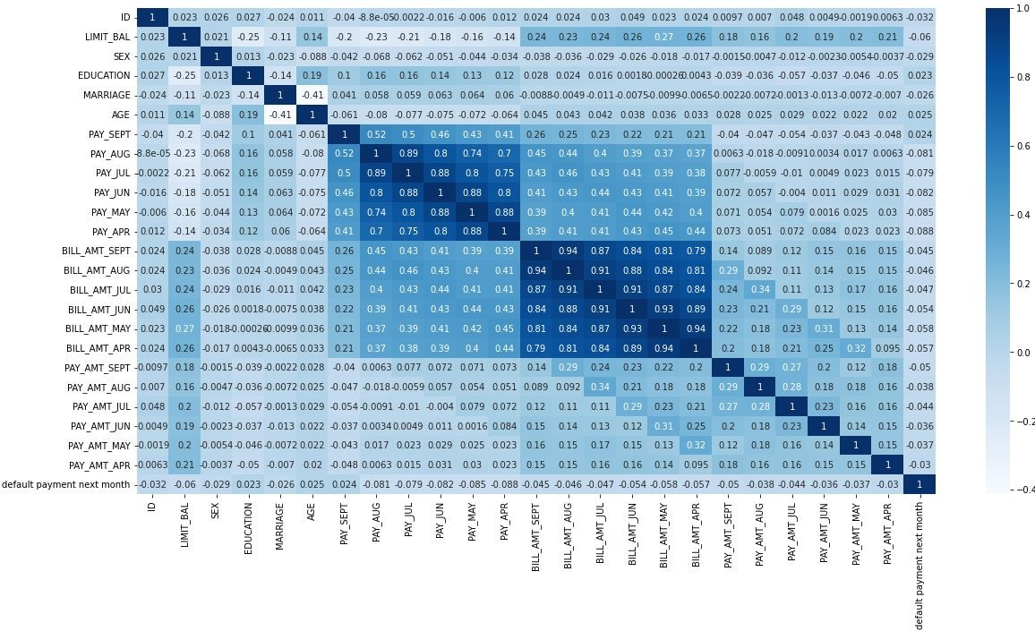
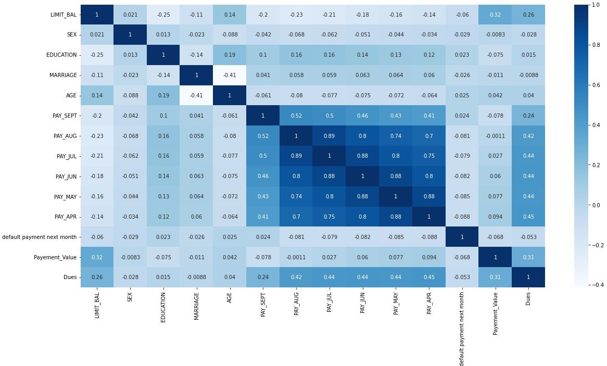
Feature Engineering
Creating Payement_Value and Dues columns from X12-X17: Amount of bill statement (NT dollar) and X18-X23: Amount of previous payment (NT dollar) to treat multicollinearity and also for outliers
Before Feature Engineering
After Feature Engineering

Slide 15
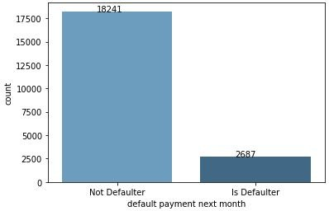
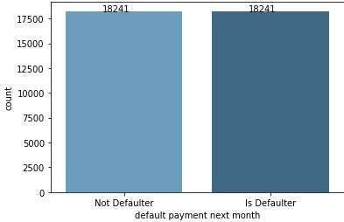
Handling Class Imbalance
We used Smote among the available methods for handling heavily imbalanced data
Before Handling Class Imbalance
After Handling Class Imbalance

Slide 16
Scaling Numerical Feature: We used Standard Scaler to scale numerical variables by removing the mean and scaling to unit variance.
Dummification: We used dummies to convert categorical variables
['EDUCATION','MARRIAGE’] into dummies variables of 1 and 0.

Slide 17
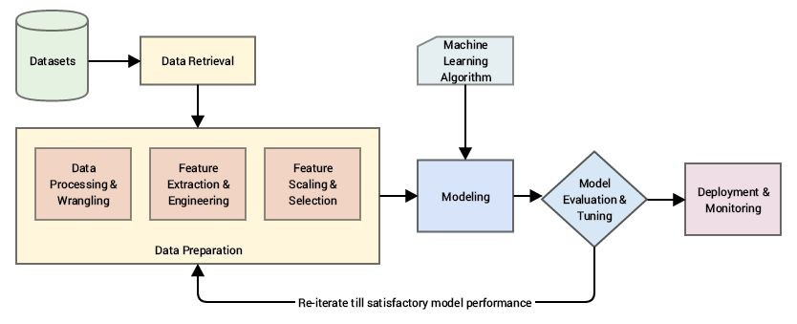
ML Model
After performing all these steps our dataset is ready for ML Modeling. Now we will train a model over a set of data, providing it an algorithm that it can use to reason over and learn from those data and then making predictions on those data which hasn’t been seen.

Slide 18
ML Model Performance
After performing various classification techniques on our predictive model and we found out that XGboost Classifier and Random Forest Classifier has performed better than any other Classification model with 83.1% and 84.4 % Precision respectively while having accuracy of 83.6% and 84% respectively
Classification Techniques | Precision | Recall | Accuracy | F1 Score | ROC_AUC
Logistic Regression | 0.72568 | 0.72223 | 0.73016 | 0.72395 | 0.73000
Support vector Classifier | 0.71528 | 0.76518 | 0.75414 | 0.73939 | 0.75504
Decision Tree | 0.76587 | 0.77879 | 0.77977 | 0.77228 | 0.77973
Random Forest | 0.84485 | 0.83523 | 0.84308 | 0.84001 | 0.84298
XGboost | 0.83164 | 0.83305 | 0.83664 | 0.83234 | 0.83655

Slide 19
Hyperparameter Tuned ML Model Performance
After performing various classification techniques on our predictive model and we found out that XGboost Classifier and Random Forest Classifier has performed better than any other Classification model with 83.1% and 84.4 % Precision respectively while having accuracy of 83.6% and 84% respectively
Classification Techniques | Precision | Recall | Accuracy | F1 Score | ROC_AUC | Best Parameters
Logistic Regression | 0.7256 | 0.7222 | 0.7301 | 0.7239 | 0.7300 | 'C': 0.1, 'max_iter': 50, 'penalty': 'l2'
SVC Classifier | 0.7152 | 0.7651 | 0.7541 | 0.7393 | 0.7550 | {'C': 1.0}
Decision Tree | 0.7658 | 0.7787 | 0.7797 | 0.7722 | 0.7797 | 'min_samples_leaf': 2, 'min_samples_split': 2
Random Forest | 0.8448 | 0.8352 | 0.8430 | 0.8400 | 0.8429 | min_samples_leaf': 2, 'min_samples_split': 2
XGboost | 0.8316 | 0.8330 | 0.8366 | 0.8323 | 0.8365 | 'learning_rate': 0.6

Slide 20
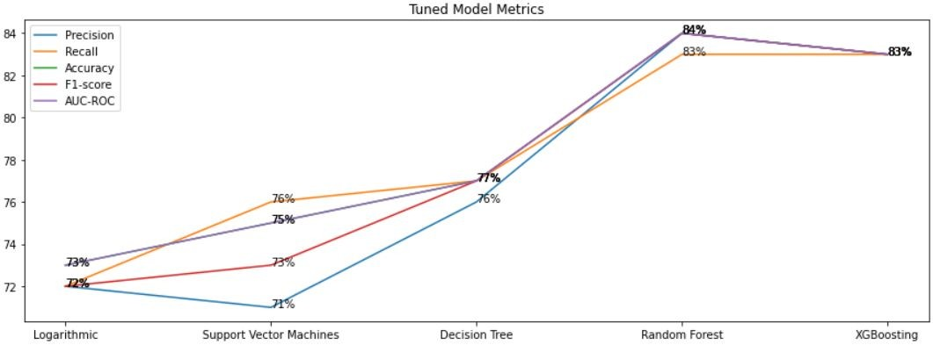
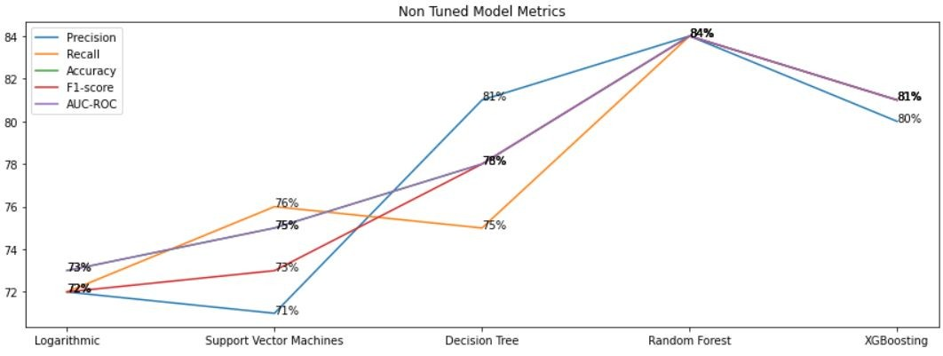
Feature Importance of Tuned Models
After analysis here are the
metric plots for both tuned
and untuned classification
models

Slide 21
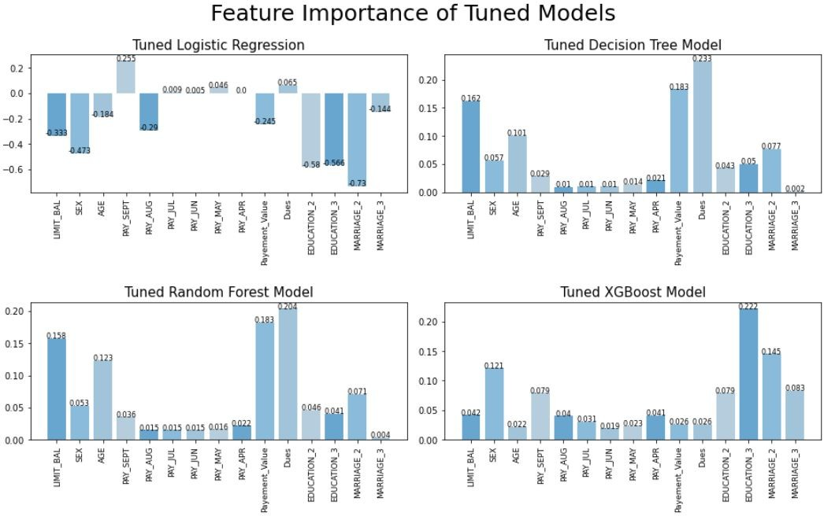
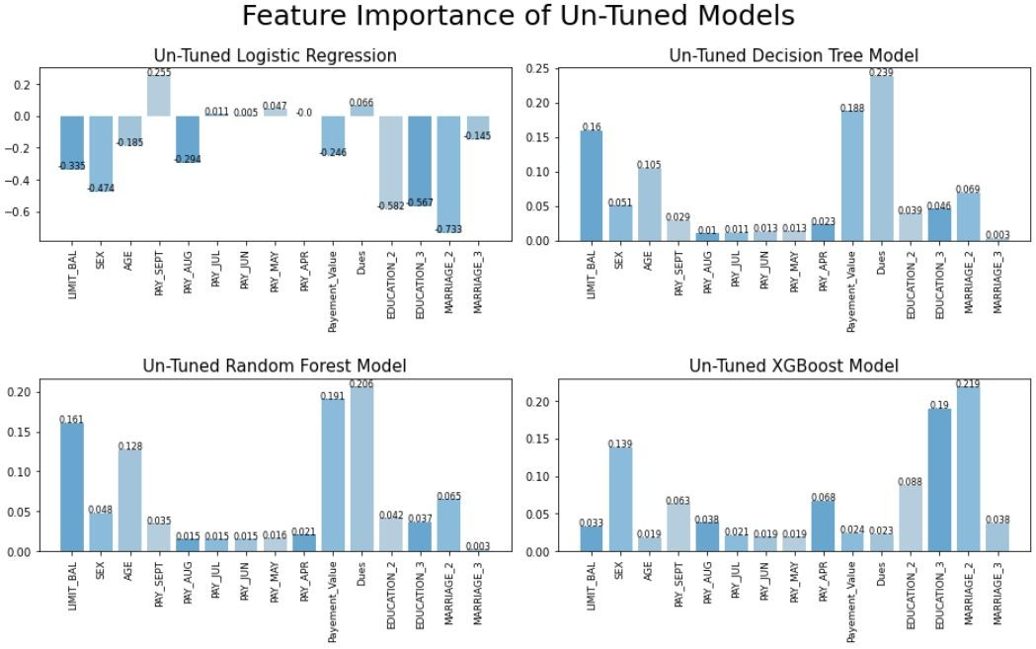
Feature Importance of Tuned Models
After analysis here are the Feature Importance for both tuned and untuned classification models

Slide 22
Performance of Model using Cross Validation
After selecting our Random Forest Classifier model we can see performance of our model using cross validation.
According to cross validate method of sklearn:
The average time for fitting the estimator on the train set is 1.67159
The average time for scoring the estimator on the test set is 0.1791
The average Accuracy for Estimator is 0.83324

Slide 23
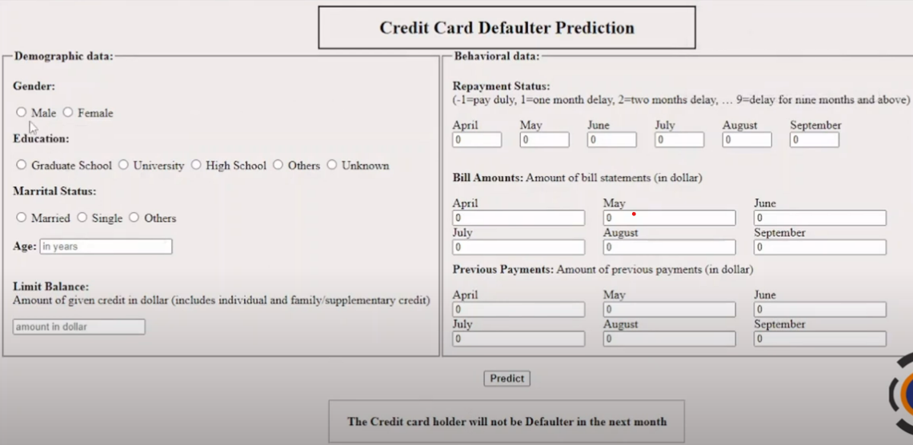
Application for Decision Making

Slide 24
Challenges Faced
Handling and understanding varied banking data.(30000 number of records and 24 number of fields )
Columns with improper data type and wrong values.
Combining, creating and removing columns.
Records containing more than 50% of nan values and replacing it with substitutes.
Removing and replacing outliers from dependent and independent variables.
Reducing skewness from the variables.
Feature selections for ML Model.
Converting columns with categorical variables to integer type and scaling numerical variables for Classification models.
Performing and choosing right kind of model.
Hyperparameter Tuning consumed lot of time and computational resources

Slide 25
Conclusion
The number of people who will default their payment is much less than number of people of people who will pay on time
The Number of females are much more than males in our dataset (6,224) and we can also say that females tend to pay their default on time compared to their male counterparts
Married people are more likely to pay their default payments compared to singles and others
We can also say that Singles do not pay their default payment marginally as compared to married counterparts
From pair plot 1 Bill amount for each month is highly correlated with each other hence we will try to feature engineer bill amount to Dues column to reduce multicollinearity
From pair plot 2 we can see that pay amount tends to clutter at one place hence we can try to feature engineer pay amount columns to one payment column to declutter our data
From history of past payment analysis it is clear that most people who pay duly are not likely to default their payment
Here, we can say from age 21 to 39 limit balance is increasing however from 39 to 61 it started to decline and then from 62 to 79 it has increased drastically

Slide 26
In our dataset, We used many algorithm like Logistic Regression,Support vector classsifier,decision tree classifier,XGBoost Classifier,Random Forest Classifier.Random Forest was the best performing algorithm as shown below:
Random Forest Classifier has the best value of accuracy score of 84%
Random Forest Classifier has the best value of precision score of 84%
Random Forest Classifier has the best value of recall score of 83%
Random Forest Classifier has the best value of f1 score of 84%
Random Forest Classifier has the best value of Roc_auc score of 84%e dataset
Random Forest Classifier gave the highest importance to Dues then to payment value and then to limit balance columns accordingly
The Performance of our best model :RandomForestClassifier(min_samples_split=4, random_state=42) with GridSearch parameters: {'min_samples_leaf': 1, 'min_samples_split': 4} according to cross validate method of sklearn:
The average time for fitting the estimator on the train set is 1.67159
The average time for scoring the estimator on the test set is 0.1791
The average Accuracy for Estimator is 0.83324

Slide 27
END OF CAPSTONE PROJECT BY DBI002 GROUP 4
THANK YOU

